Slide 1
Cédric
Notes:
Hi, my name is Cédric and I will present the project I am working on as part of my IT training, my application named Bagueton. Before, let me introduce myself in a few words. I graduated from an high school with an electronic’s diploma, that I did in two thousand and eight. After this, I had several jobs, mostly manual jobs. Lastly, I worked as a baker for 6 years, and I found some issues, that I will try to solve with the application I will now show you.
This presentation will be made following 3 main axes:
First, I will present you the project, and the issues I will try to resolve.
Then, the modeling including zonings wireframes and mockups.
Finaly, the use case and the tree structure of my android application.

Slide 2
Cédric
« Bagueton »
Notes:
Hi, my name is Cédric and I will present the project I am working on as part of my IT training, Bageton. Before, let me introduce myself in a few words. I graduated from an high school with an electronic’s diploma, that I did in two thousand and eight. After this, I had several jobs, mostly manual jobs. Lastly, I worked as a baker for 6 years, and I found some issues, that I will try to solve with the application I will now show you.
This presentation will be made following 3 main axes:
First, I will present you the project, and the issues I will try to resolve.
Then, the modeling including zonings wireframes and mockups.
Finaly, the use case and the tree structure of my android application.

Slide 3
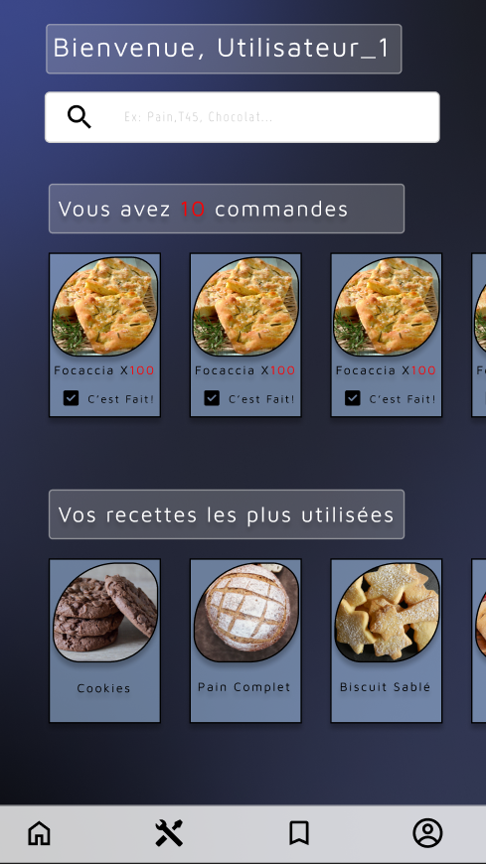
Cédric
Bagueton
Notes:
Hi, my name is Cédric and I will present the project I am working on as part of my IT training, Bageton. Before, let me introduce myself in a few words. I graduated from an high school with an electronic’s diploma, that I did in two thousand and eight. After this, I had several jobs, mostly manual jobs. Lastly, I worked as a baker for 6 years, and I found some issues, that I will try to solve with the application I will now show you.
This presentation will be made following 3 main axes:
First, I will present you the project, and the issues I will try to resolve.
Then, the modeling including zonings wireframes and mockups.
Finaly, the use case and the tree structure of my android application.

Slide 4
Cédric
Notes:
Hi, my name is Cédric and I will present the project I am working on as part of my IT training, Bageton. Before, let me introduce myself in a few words. I graduated from an high school with an electronic’s diploma, that I did in two thousand and eight. After this, I had several jobs, mostly manual jobs. Lastly, I worked as a baker for 6 years, and I found some issues, that I will try to solve with the application I will now show you.
This presentation will be made following 3 main axes:
First, I will present you the project, and the issues I will try to resolve.
Then, the modeling including zonings wireframes and mockups.
Finaly, the use case and the tree structure of my android application.

Slide 5

Cédric
Electronic’s diploma in 2008
Notes:
Hi, my name is Cédric and I will present the project I am working on as part of my IT training, Bageton. Before, let me introduce myself in a few words. I graduated from an high school with an electronic’s diploma, that I did in two thousand and eight. After this, I had several jobs, mostly manual jobs. Lastly, I worked as a baker for 6 years, and I found some issues, that I will try to solve with the application I will now show you.
This presentation will be made following 3 main axes:
First, I will present you the project, and the issues I will try to resolve.
Then, the modeling including zonings wireframes and mockups.
Finaly, the use case and the tree structure of my android application.

Slide 6

Cédric
Baker for over 6 years
Notes:
Hi, my name is Cédric and I will present the project I am working on as part of my IT training, Bageton. Before, let me introduce myself in a few words. I graduated from an high school with an electronic’s diploma, that I did in two thousand and eight. After this, I had several jobs, mostly manual jobs. Lastly, I worked as a baker for 6 years, and I found some issues, that I will try to solve with the application I will now show you.
This presentation will be made following 3 main axes:
First, I will present you the project, and the issues I will try to resolve.
Then, the modeling including zonings wireframes and mockups.
Finaly, the use case and the tree structure of my android application.

Slide 7
« Bagueton »
Notes:
Hi, my name is Cédric and I will present the project I am working on as part of my IT training, Bagueton. Before, let me introduce myself in a few words. I graduated from an high school with an electronic’s diploma, that I did in two thousand and eight. After this, I had several jobs, mostly manual jobs. Lastly, I worked as a baker for 6 years, and I found some issues, that I will try to solve with the application I will now show you.
This presentation will be made following 3 main axes:
First, I will present you the project, and the issues I will try to resolve.
Then, the modeling including zonings wireframes and mockups.
Finaly, the use case and the tree structure of my android application.

Slide 8
Issues
« Bagueton »
Notes:
Hi, my name is Cédric and I will present the project I am working on as part of my IT training, Bagueton. Before, let me introduce myself in a few words. I graduated from an high school with an electronic’s diploma, that I did in two thousand and eight. After this, I had several jobs, mostly manual jobs. Lastly, I worked as a baker for 6 years, and I found some issues, that I will try to solve with the application I will now show you.
This presentation will be made following 3 main axes:
First, I will present you the project, and the issues I will try to resolve.
Then, the modeling including zonings wireframes and mockups.
Finaly, the use case and the tree structure of my android application.

Slide 9
Issues
- Recipes
« Bagueton »
Notes:
Hi, my name is Cédric and I will present the project I am working on as part of my IT training, Bagueton. Before, let me introduce myself in a few words. I graduated from an high school with an electronic’s diploma, that I did in two thousand and eight. After this, I had several jobs, mostly manual jobs. Lastly, I worked as a baker for 6 years, and I found some issues, that I will try to solve with the application I will now show you.
This presentation will be made following 3 main axes:
First, I will present you the project, and the issues I will try to resolve.
Then, the modeling including zonings wireframes and mockups.
Finaly, the use case and the tree structure of my android application.

Slide 10
Issues
- Recipes (calculation, take notes, photography of creations..)
« Bagueton »
Notes:
Hi, my name is Cédric and I will present the project I am working on as part of my IT training, Bagueton. Before, let me introduce myself in a few words. I graduated from an high school with an electronic’s diploma, that I did in two thousand and eight. After this, I had several jobs, mostly manual jobs. Lastly, I worked as a baker for 6 years, and I found some issues, that I will try to solve with the application I will now show you.
This presentation will be made following 3 main axes:
First, I will present you the project, and the issues I will try to resolve.
Then, the modeling including zonings wireframes and mockups.
Finaly, the use case and the tree structure of my android application.

Slide 11
Issues
- Recipes (calculations, taking notes, photographies..)
- Tools
« Bagueton »
Notes:
Hi, my name is Cédric and I will present the project I am working on as part of my IT training, Bagueton. Before, let me introduce myself in a few words. I graduated from an high school with an electronic’s diploma, that I did in two thousand and eight. After this, I had several jobs, mostly manual jobs. Lastly, I worked as a baker for 6 years, and I found some issues, that I will try to solve with the application I will now show you.
This presentation will be made following 3 main axes:
First, I will present you the project, and the issues I will try to resolve.
Then, the modeling including zonings wireframes and mockups.
Finaly, the use case and the tree structure of my android application.

Slide 12
Issues
- Recipes (calcules, taking notes, photographies..)
- Tools (programming freezer, timer..)
« Bagueton »
Notes:
Hi, my name is Cédric and I will present the project I am working on as part of my IT training, Bagueton. Before, let me introduce myself in a few words. I graduated from an high school with an electronic’s diploma, that I did in two thousand and eight. After this, I had several jobs, mostly manual jobs. Lastly, I worked as a baker for 6 years, and I found some issues, that I will try to solve with the application I will now show you.
This presentation will be made following 3 main axes:
First, I will present you the project, and the issues I will try to resolve.
Then, the modeling including zonings wireframes and mockups.
Finaly, the use case and the tree structure of my android application.

Slide 13
Issues
- Recipes (calcules, taking notes, photographies..)
- Tools (programming freezer, timer..)
- Schedule
« Bagueton »
Notes:
Hi, my name is Cédric and I will present the project I am working on as part of my IT training, Bagueton. Before, let me introduce myself in a few words. I graduated from an high school with an electronic’s diploma, that I did in two thousand and eight. After this, I had several jobs, mostly manual jobs. Lastly, I worked as a baker for 6 years, and I found some issues, that I will try to solve with the application I will now show you.
This presentation will be made following 3 main axes:
First, I will present you the project, and the issues I will try to resolve.
Then, the modeling including zonings wireframes and mockups.
Finaly, the use case and the tree structure of my android application.

Slide 14
Issues
- Recipes (calcules, taking notes, photographies..)
- Tools (programming freezer, timer..)
- Schedule (mostly used for order)
« Bagueton »
Notes:
Hi, my name is Cédric and I will present the project I am working on as part of my IT training, Bagueton. Before, let me introduce myself in a few words. I graduated from an high school with an electronic’s diploma, that I did in two thousand and eight. After this, I had several jobs, mostly manual jobs. Lastly, I worked as a baker for 6 years, and I found some issues, that I will try to solve with the application I will now show you.
This presentation will be made following 3 main axes:
First, I will present you the project, and the issues I will try to resolve.
Then, the modeling including zonings wireframes and mockups.
Finaly, the use case and the tree structure of my android application.

Slide 15
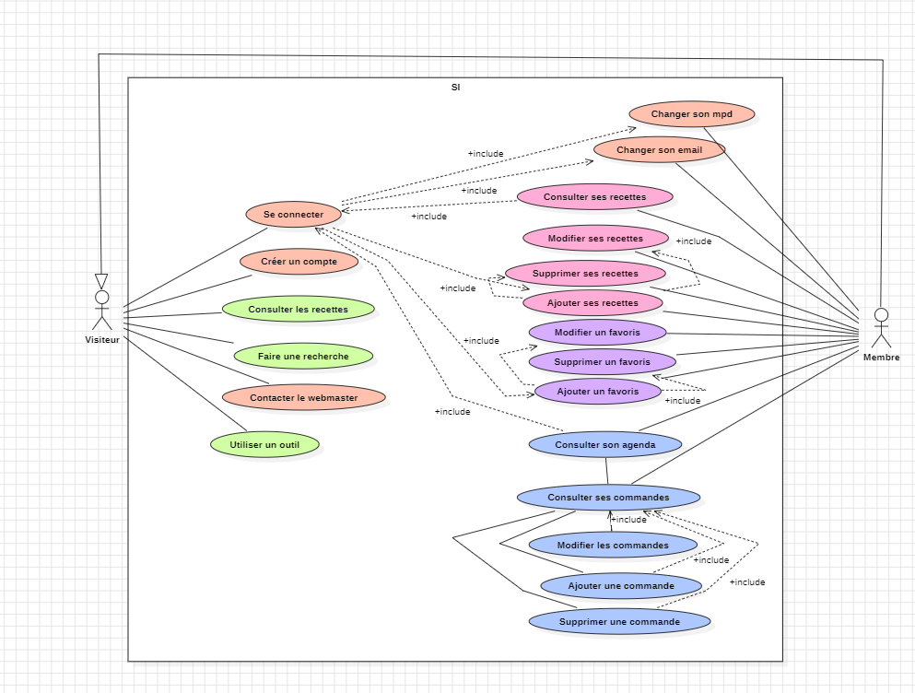
Use case
Notes:
Hi, my name is Cédric and I will present the project I am working on as part of my IT training, Bagueton. Before, let me introduce myself in a few words. I graduated from an high school with an electronic’s diploma, that I did in two thousand and eight. After this, I had several jobs, mostly manual jobs. Lastly, I worked as a baker for 6 years, and I found some issues, that I will try to solve with the application I will now show you.
This presentation will be made following 3 main axes:
First, I will present you the project, and the issues I will try to resolve.
Then, the modeling including zonings wireframes and mockups.
Finaly, the use case and the tree structure of my android application.

Slide 16
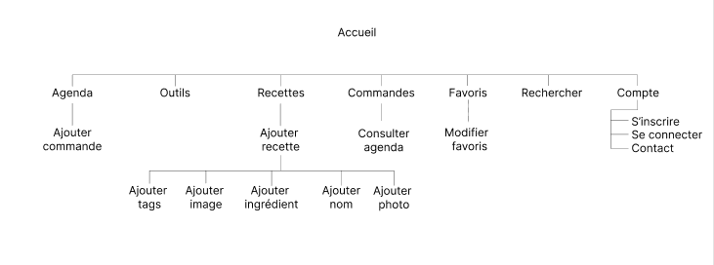
Application tree
Notes:
Hi, my name is Cédric and I will present the project I am working on as part of my IT training, Bagueton. Before, let me introduce myself in a few words. I graduated from an high school with an electronic’s diploma, that I did in two thousand and eight. After this, I had several jobs, mostly manual jobs. Lastly, I worked as a baker for 6 years, and I found some issues, that I will try to solve with the application I will now show you.
This presentation will be made following 3 main axes:
First, I will present you the project, and the issues I will try to resolve.
Then, the modeling including zonings wireframes and mockups.
Finaly, the use case and the tree structure of my android application.

Slide 17
« Bagueton »
Zonning
Notes:
Hi, my name is Cédric and I will present the project I am working on as part of my IT training, Bagueton. Before, let me introduce myself in a few words. I graduated from an high school with an electronic’s diploma, that I did in two thousand and eight. After this, I had several jobs, mostly manual jobs. Lastly, I worked as a baker for 6 years, and I found some issues, that I will try to solve with the application I will now show you.
This presentation will be made following 3 main axes:
First, I will present you the project, and the issues I will try to resolve.
Then, the modeling including zonings wireframes and mockups.
Finaly, the use case and the tree structure of my android application.

Slide 18

« Bagueton »
Zonning
Notes:
Hi, my name is Cédric and I will present the project I am working on as part of my IT training, Bagueton. Before, let me introduce myself in a few words. I graduated from an high school with an electronic’s diploma, that I did in two thousand and eight. After this, I had several jobs, mostly manual jobs. Lastly, I worked as a baker for 6 years, and I found some issues, that I will try to solve with the application I will now show you.
This presentation will be made following 3 main axes:
First, I will present you the project, and the issues I will try to resolve.
Then, the modeling including zonings wireframes and mockups.
Finaly, the use case and the tree structure of my android application.

Slide 19
« Bagueton »
Wireframe
Notes:
Hi, my name is Cédric and I will present the project I am working on as part of my IT training, Bagueton. Before, let me introduce myself in a few words. I graduated from an high school with an electronic’s diploma, that I did in two thousand and eight. After this, I had several jobs, mostly manual jobs. Lastly, I worked as a baker for 6 years, and I found some issues, that I will try to solve with the application I will now show you.
This presentation will be made following 3 main axes:
First, I will present you the project, and the issues I will try to resolve.
Then, the modeling including zonings wireframes and mockups.
Finaly, the use case and the tree structure of my android application.

Slide 20
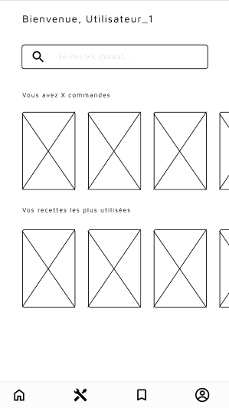
« Bagueton »
Wireframe
Notes:
Hi, my name is Cédric and I will present the project I am working on as part of my IT training, Bagueton. Before, let me introduce myself in a few words. I graduated from an high school with an electronic’s diploma, that I did in two thousand and eight. After this, I had several jobs, mostly manual jobs. Lastly, I worked as a baker for 6 years, and I found some issues, that I will try to solve with the application I will now show you.
This presentation will be made following 3 main axes:
First, I will present you the project, and the issues I will try to resolve.
Then, the modeling including zonings wireframes and mockups.
Finaly, the use case and the tree structure of my android application.

Slide 21
« Bagueton »
Mockup
Notes:
Hi, my name is Cédric and I will present the project I am working on as part of my IT training, Bagueton. Before, let me introduce myself in a few words. I graduated from an high school with an electronic’s diploma, that I did in two thousand and eight. After this, I had several jobs, mostly manual jobs. Lastly, I worked as a baker for 6 years, and I found some issues, that I will try to solve with the application I will now show you.
This presentation will be made following 3 main axes:
First, I will present you the project, and the issues I will try to resolve.
Then, the modeling including zonings wireframes and mockups.
Finaly, the use case and the tree structure of my android application.

Slide 22
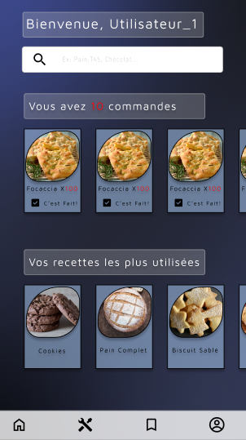
« Bagueton »
Mockup
Notes:
Hi, my name is Cédric and I will present the project I am working on as part of my IT training, Bagueton. Before, let me introduce myself in a few words. I graduated from an high school with an electronic’s diploma, that I did in two thousand and eight. After this, I had several jobs, mostly manual jobs. Lastly, I worked as a baker for 6 years, and I found some issues, that I will try to solve with the application I will now show you.
This presentation will be made following 3 main axes:
First, I will present you the project, and the issues I will try to resolve.
Then, the modeling including zonings wireframes and mockups.
Finaly, the use case and the tree structure of my android application.

Slide 23
Thank you
Notes:
Hi, my name is Cédric and I will present the project I am working on as part of my IT training, Bagueton. Before, let me introduce myself in a few words. I graduated from an high school with an electronic’s diploma, that I did in two thousand and eight. After this, I had several jobs, mostly manual jobs. Lastly, I worked as a baker for 6 years, and I found some issues, that I will try to solve with the application I will now show you.
This presentation will be made following 3 main axes:
First, I will present you the project, and the issues I will try to resolve.
Then, the modeling including zonings wireframes and mockups.
Finaly, the use case and the tree structure of my android application.

Slide 24

Thank you
Notes:
Hi, my name is Cédric and I will present the project I am working on as part of my IT training, Bagueton. Before, let me introduce myself in a few words. I graduated from an high school with an electronic’s diploma, that I did in two thousand and eight. After this, I had several jobs, mostly manual jobs. Lastly, I worked as a baker for 6 years, and I found some issues, that I will try to solve with the application I will now show you.
This presentation will be made following 3 main axes:
First, I will present you the project, and the issues I will try to resolve.
Then, the modeling including zonings wireframes and mockups.
Finaly, the use case and the tree structure of my android application.

